Slide 1
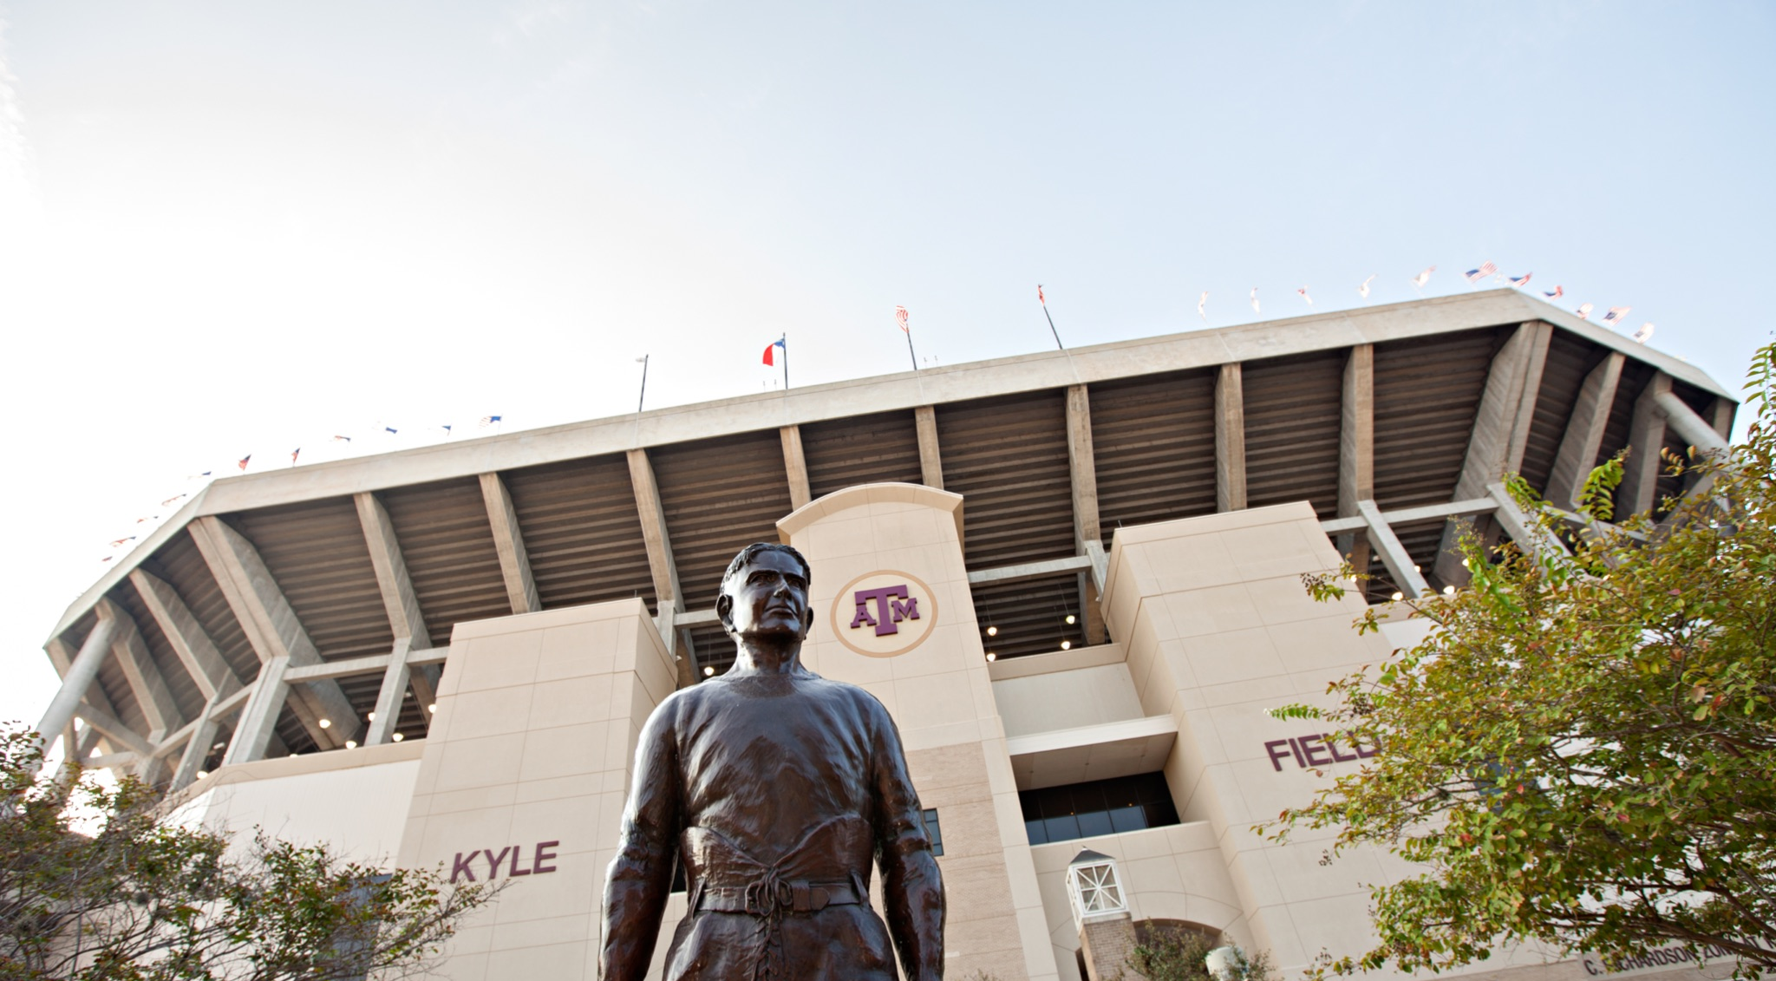

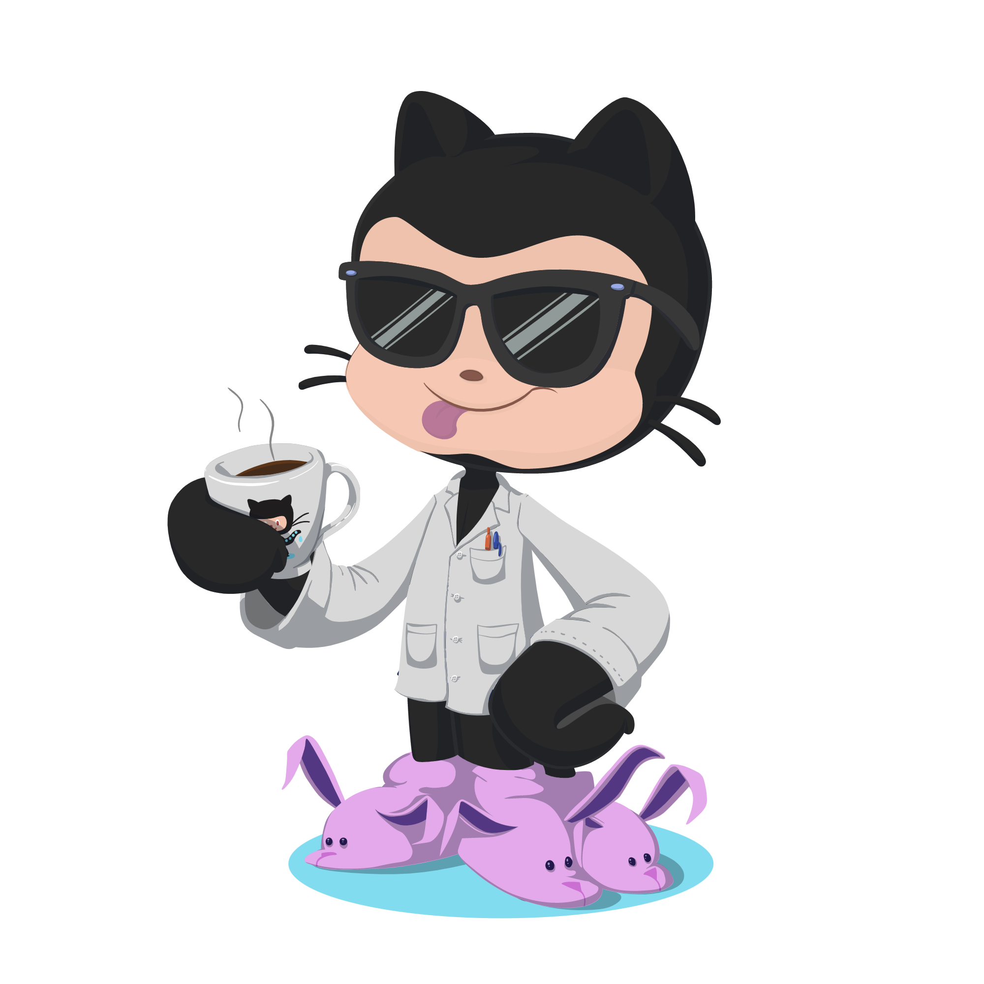
GitHub Flow Intro & Demo

Slide 2
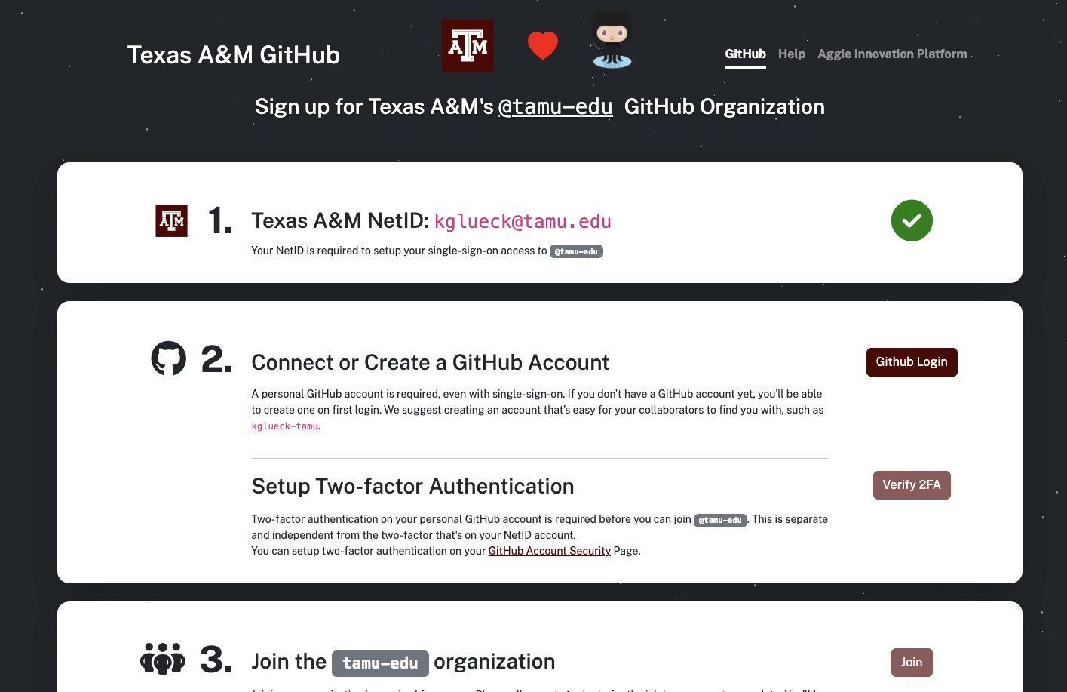
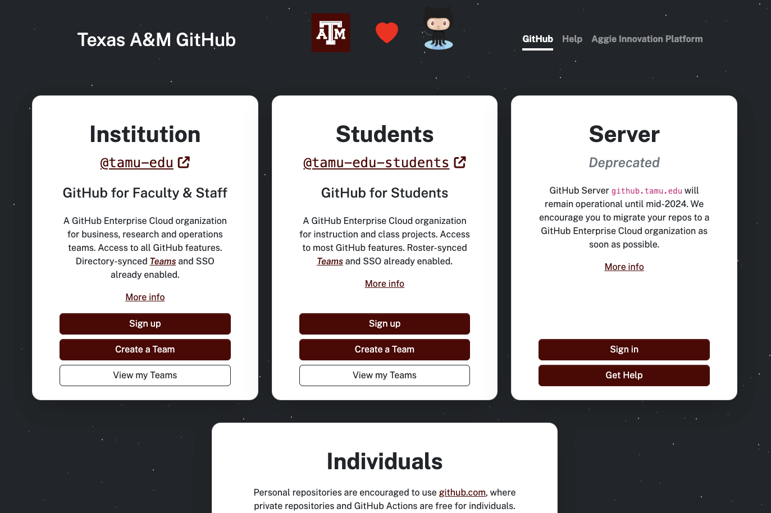

Getting into TAMU's GitHub Organization
Visit https://github.cloud.tamu.edu
Notes:
Introduce self
- Started as "AIP”: the Aggie Innovation Platform
- Our true goal was to reimagine and reinvent how enterprise IT was done at TAMU.
- And to influence the culture at TAMU to believe in processes with less toil, lower entropy, and higher efficiency.
- And we all really love robots.
For most of TAMU, we are the “service owner” of the Public Clouds.

Slide 3
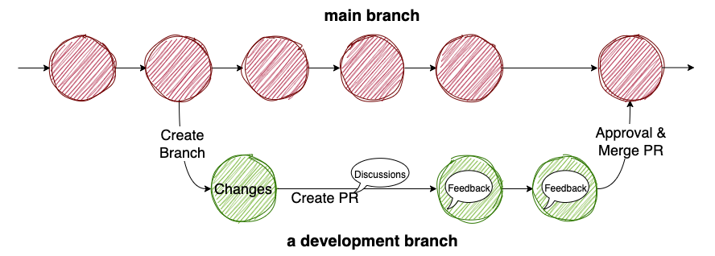
Git Flow – What is it?
Create a new branch from main
Make and commit changes to new branch
Create a pull request
Address review comments
Merge the pull request
Delete the branch
Notes:
Introduce self
- Started as "AIP”: the Aggie Innovation Platform
- Our true goal was to reimagine and reinvent how enterprise IT was done at TAMU.
- And to influence the culture at TAMU to believe in processes with less toil, lower entropy, and higher efficiency.
- And we all really love robots.
For most of TAMU, we are the “service owner” of the Public Clouds.

Slide 4
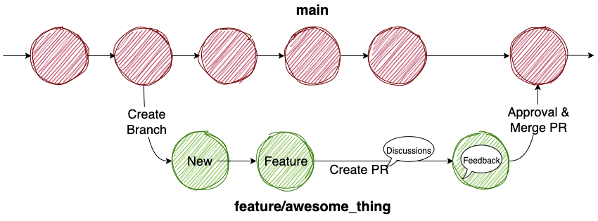
Git Flow - Branch specifics
Default branch is now main
Formerly master
Create new branches to do feature development, bugfixes, and hotfixes
A basic naming convention for branches eases understanding
Always make sure your local repository is up to date with upstream
Commit changes to your working branch
Notes:
Introduce self
- Started as "AIP”: the Aggie Innovation Platform
- Our true goal was to reimagine and reinvent how enterprise IT was done at TAMU.
- And to influence the culture at TAMU to believe in processes with less toil, lower entropy, and higher efficiency.
- And we all really love robots.
For most of TAMU, we are the “service owner” of the Public Clouds.

Slide 5
Git Flow Example
Pull Requests facilitate discussion and approvals around a merge before it happens
Real World Example
Notes:
Introduce self
- Started as "AIP”: the Aggie Innovation Platform
- Our true goal was to reimagine and reinvent how enterprise IT was done at TAMU.
- And to influence the culture at TAMU to believe in processes with less toil, lower entropy, and higher efficiency.
- And we all really love robots.
For most of TAMU, we are the “service owner” of the Public Clouds.

Slide 6
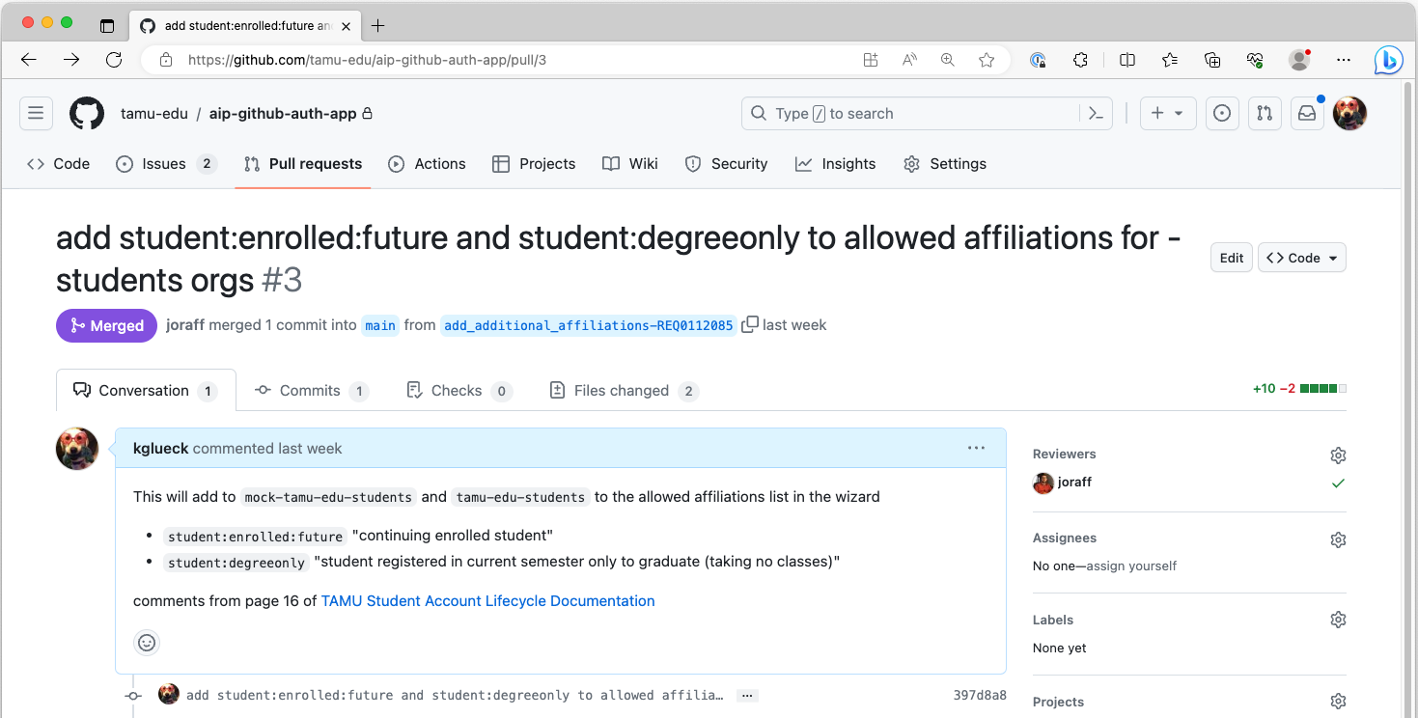
Git Flow Example
Notes:
Introduce self
- Started as "AIP”: the Aggie Innovation Platform
- Our true goal was to reimagine and reinvent how enterprise IT was done at TAMU.
- And to influence the culture at TAMU to believe in processes with less toil, lower entropy, and higher efficiency.
- And we all really love robots.
For most of TAMU, we are the “service owner” of the Public Clouds.

Slide 7
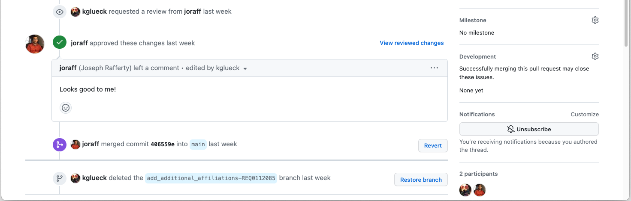
Git Flow Example
Notes:
Introduce self
- Started as "AIP”: the Aggie Innovation Platform
- Our true goal was to reimagine and reinvent how enterprise IT was done at TAMU.
- And to influence the culture at TAMU to believe in processes with less toil, lower entropy, and higher efficiency.
- And we all really love robots.
For most of TAMU, we are the “service owner” of the Public Clouds.

Slide 8
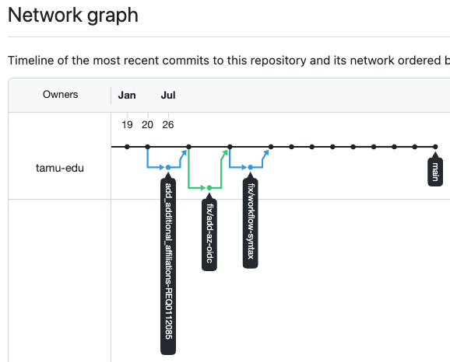
Git Flow Example
Notes:
Introduce self
- Started as "AIP”: the Aggie Innovation Platform
- Our true goal was to reimagine and reinvent how enterprise IT was done at TAMU.
- And to influence the culture at TAMU to believe in processes with less toil, lower entropy, and higher efficiency.
- And we all really love robots.
For most of TAMU, we are the “service owner” of the Public Clouds.

Slide 9
Lab 1
Sign-in to github.com
Go to skills.github.com
Choose Introduction to GitHub
Scroll down to How to start this course
click Start Course
Use your personal GitHub account
https://myoctocat.com
Notes:
Introduce self
- Started as "AIP”: the Aggie Innovation Platform
- Our true goal was to reimagine and reinvent how enterprise IT was done at TAMU.
- And to influence the culture at TAMU to believe in processes with less toil, lower entropy, and higher efficiency.
- And we all really love robots.
For most of TAMU, we are the “service owner” of the Public Clouds.

Slide 10
Client Tool Options
Command-line, git
GitHub Web Interface (such as was used in the Lab environment)
GitHub Desktop (https://desktop.github.com)
Visual Studio Code (https://code.visualstudio.com)
Many, many other commercial options (Tower, GitKraken, …)
Notes:
Introduce self
- Started as "AIP”: the Aggie Innovation Platform
- Our true goal was to reimagine and reinvent how enterprise IT was done at TAMU.
- And to influence the culture at TAMU to believe in processes with less toil, lower entropy, and higher efficiency.
- And we all really love robots.
For most of TAMU, we are the “service owner” of the Public Clouds.

